Slide 1

Testing Automation for GenomeSpace
Presenter: Ruijing Zhang
Supervisor: Yousef Kowsar

Slide 2

Background
Manual testing
Automated testing

Slide 3
Aims
To create a platform for validation and verification testing of GenomeSpace
Effective and efficient
Make the development of GS easier
Re-usability

Slide 4

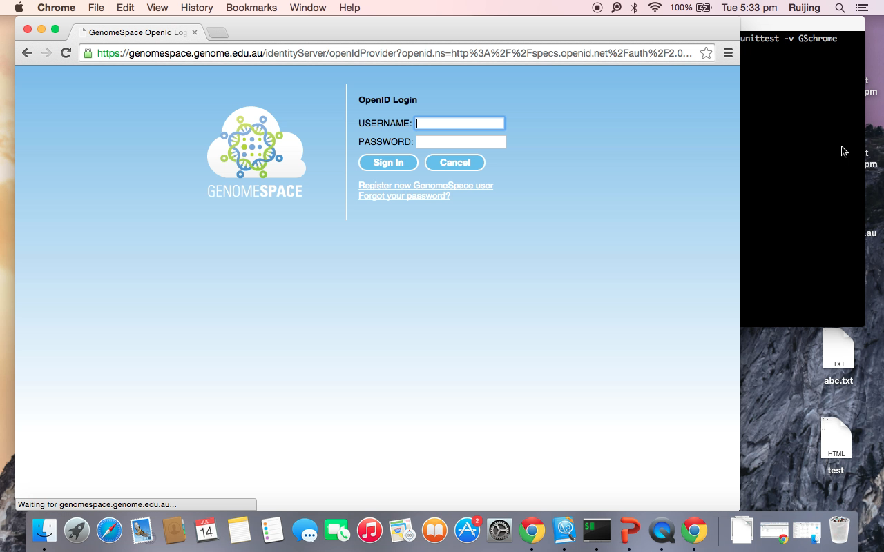
Methodology
Selenium
Unittest

Slide 5
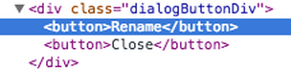
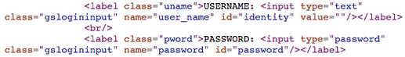
Results and Analysis
Interface or Services

Slide 6
Conclusions
Benefits
Limitations
https://www.vlsci.org.au/

